Slide 1

Mini-Project Group 4
Interesting Findings
Katelyn Poon, Edwin Lopez, Owen Davis, Isabel Chen, Sethya Pugal

Slide 2
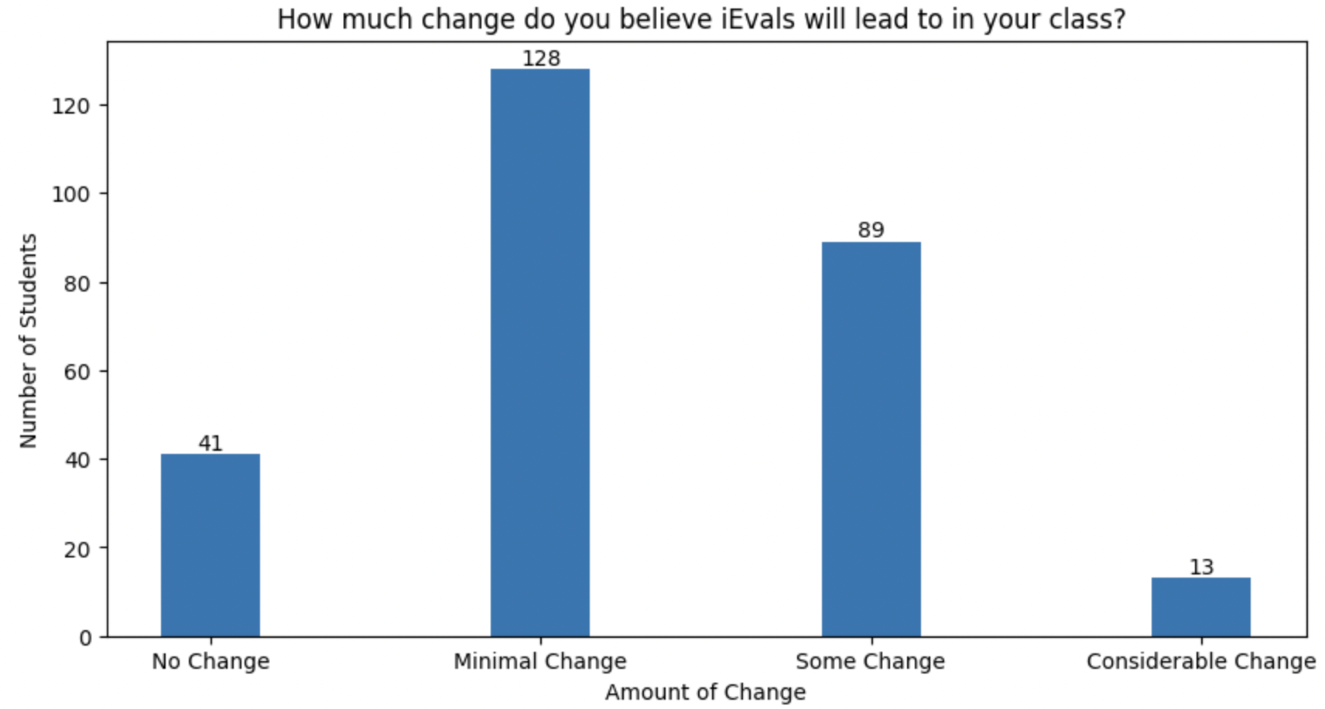
No Belief in Major Change (Katelyn)
One thing that was surprising was the fact that no one in the survey believed that the iEvals brought major change to classes. It was expected that there would at least be some small minority who believe that iEvals bring major change.
Influence of Passion vs. Salary on Student Feedback in iEval (Isabel Chen) Students who chose their major driven by interest or passion are more than twice as likely to voice their opinion in iEval, with a probability of 0.42, compared to those motivated by salary prospects, who have a probability of just 0.20.
Exploring the Relationship Between Student Age and Confidence in iEval's Effectiveness (Edwin Lopez) Chi-square test, p value of 0.52 didn't demonstrate a sufficient relationship between student age and confidence in iEval; Despite this, a redesigned study considering factors such as academic year, experience with iEval, duration of enrollment at UCR, and prior attendance at other universities may uncover more substantial insights.

Slide 3
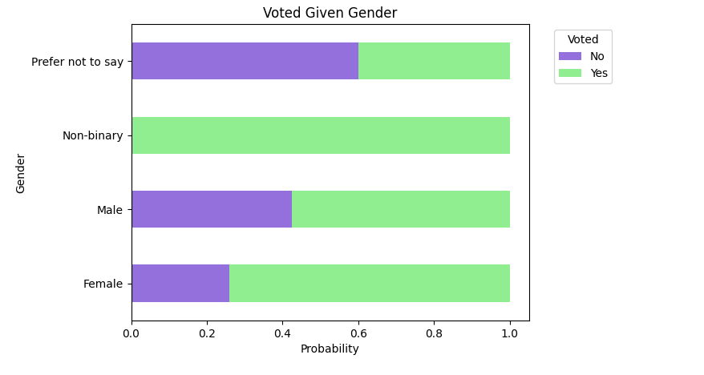
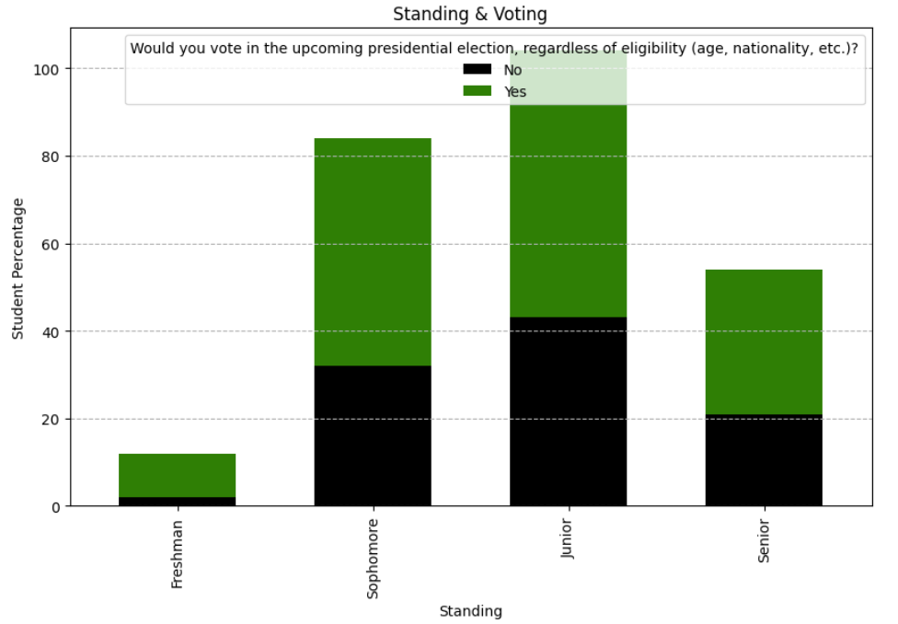
Voting Decline (Owen)
The survey revealed that as students progressed through college they become less likely to vote. Due to freshmen overwhelmingly wanting to vote it could be interpreted that students are excited to participate in their first election, with interest declining from there.
Gender and Voting (Sethya)
Ran a chi square test that proved a strong dependence between voting given male and female. That was like the most significant thing lol. P much everything i did was significant tho 😎.

